Slide 1
SYNTAX ANALYSIS OR PARSING
Lecture 06

Slide 2
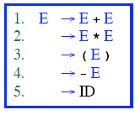
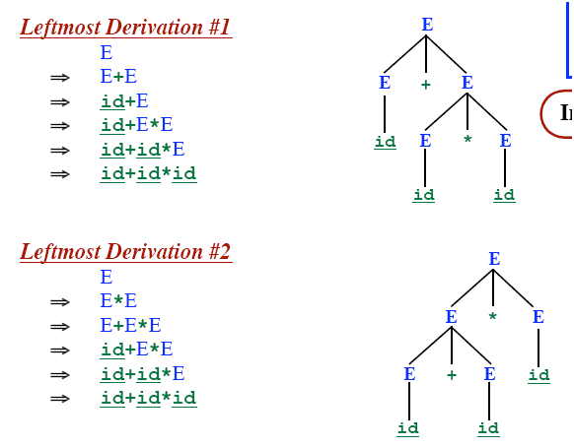

AMBIGUOUS GRAMMAR
‹#›

Slide 3
AMBIGUOUS GRAMMAR
More than one Parse Tree for some sentence.
The grammar for a programming language may be ambiguous
Need to modify it for parsing.
Also: Grammar may be left recursive.
Need to modify it for parsing.
‹#›

Slide 4
ELIMINATION OF AMBIGUITY
Ambiguous
A Grammar is ambiguous if there are multiple parse trees for the same sentence.
Disambiguation
Express Preference for one parse tree over others
Add disambiguating rule into the grammar
‹#›

Slide 5
RESOLVING PROBLEMS: AMBIGUOUS GRAMMARS
Consider the following grammar segment:
stmt → if expr then stmt
| if expr then stmt else stmt
| other (any other statement)
If E1 then S1 else if E2 then S2 else S3
simple parse tree:
stmt
if
expr
then
stmt
else
stmt
E₁
S₁
expr
then
stmt
else
stmt
if
E₂
S₂
S₃
‹#›
Notes:
‹#›

Slide 6
EXAMPLE : WHAT HAPPENS WITH THIS STRING?
If E₁ then if E₂ then S₁ else S₂
How is this parsed ?
if E₁ then
if E₂ then
S₁
else
S₂
if E₁ then
if E₂ then
S₁
else
S₂
vs.
‹#›
Notes:
‹#›

Slide 7
PARSE TREES: IF E1 THEN IF E2 THEN S1 ELSE S2
Form 1:
stmt
if
expr
then
stmt
E₁
stmt
else
stmt
if
expr
then
E₂
S₁
S₂
Form 2:
stmt
if
expr
then
stmt
else
stmt
E₁
expr
then
stmt
S₂
if
‹#›
E₂
S₁
Notes:
‹#›

Slide 8
REMOVING AMBIGUITY
Take Original Grammar:
stmt → if expr then stmt
| if expr then stmt else stmt
| other (any other statement)
Rule: Match each else with the closest previous unmatched then.
Revise to remove ambiguity:
stmt → matched_stmt | unmatched_stmt
matched_stmt → if expr then matched_stmt else matched_stmt | other
unmatched_stmt → if expr then stmt
| if expr then matched_stmt else unmatched_stmt
‹#›
Notes:
‹#›

Slide 9
RESOLVING DIFFICULTIES : LEFT RECURSION
A left recursive grammar has rules that support the derivation : A ⇒ Aα, for some α.
+
Top-Down parsing can’t reconcile this type of grammar, since it could consistently make choice which wouldn’t allow termination.
A ⇒ Aα ⇒ Aαα ⇒ Aααα … etc. A→ Aα | β
Take left recursive grammar:
A → Aα | β
To the following:
A → βA’
A’ → αA’ | ∈
‹#›
Notes:
‹#›

Slide 10
WHY IS LEFT RECURSION A PROBLEM ?
Derive : id + id + id
E ⇒ E + T ⇒
Consider:
E → E + T | T
T → T * F | F
F → ( E ) | id
How can left recursion be removed ?
E → E + T | T What does this generate?
E ⇒ E + T ⇒ T + T
E ⇒ E + T ⇒ E + T + T ⇒ T + T + T
…
How does this build strings ?
What does each string have to start with ?
‹#›
Notes:
‹#›

Slide 11
RESOLVING DIFFICULTIES : LEFT RECURSION (2)
Informal Discussion:
Take all productions for A and order as:
A → Aα₁ | Aα₂ | … | Aα_{m} | β₁ | β₂ | … | β_{n}
Where no β_{i} begins with A.
Now apply concepts of previous slide:
A → β₁A’ | β₂A’ | … | β_{n}A’
A’ → α₁A’ | α₂A’ | … | α_{m} A’ | ∈
For our example:
E → E + T | T
T → T * F | F
F → ( E ) | id
E → TE’ E’ → + TE’ | ∈
T → FT’ T’ → * FT’ | ∈
‹#›
F → ( E ) | id
Notes:
‹#›

Slide 12
RESOLVING DIFFICULTIES : LEFT RECURSION (3)
Problem: If left recursion is two-or-more levels deep,
this isn’t enough
S → Aa | b
A → Ac | Sd | ∈
S ⇒ Aa ⇒ Sda
Algorithm:
Input: Grammar G with ordered Non-Terminals A₁, ..., A_{n}
Output: An equivalent grammar with no left recursion
Arrange the non-terminals in some order A₁=start NT,A₂,…A_{n}
for i := 1 to n do begin
for j := 1 to i – 1 do begin
replace each production of the form A_{i} → A_{j}γ
by the productions A_{i} → δ₁γ | δ₂γ | … | δ_{k}γ
where A_{j} → δ₁|δ₂|…|δ_{k} are all current A_{j} productions;
end
eliminate the immediate left recursion among A_{i} productions
end
‹#›
Notes:
‹#›

Slide 13
USING THE ALGORITHM
Apply the algorithm to: A₁ → A₂a | b| ∈
A₂ → A₂c | A₁d
i = 1
For A₁ there is no left recursion
i = 2
for j=1 to 1 do
Take productions: A₂ → A₁γ and replace with
A₂ → δ₁ γ | δ₂ γ | … | δ_{k} γ|
where A₁→ δ₁ | δ₂ | … | δ_{k} are A₁ productions
in our case A₂ → A₁d becomes A₂ → A₂ad | bd | d
What’s left: A₁→ A₂a | b | ∈
A₂ → A₂ c | A₂ ad | bd | d
‹#›
Are we done ?
Notes:
‹#›

Slide 14
USING THE ALGORITHM (2)
No ! We must still remove A₂ left recursion !
A₁→ A₂a | b | ∈
A₂ → A₂ c | A₂ ad | bd | d
Recall:
A → Aα₁ | Aα₂ | … | Aα_{m} | β₁ | β₂ | … | β_{n}
A → β₁A’ | β₂A’ | … | β_{n}A’
A’ → α₁A’ | α₂A’ | … | α_{m} A’ | ∈
A₁→ A₂a | b | ∈
A₂ → bdA₂’ | dA₂’
A₂’ → c A₂’ | adA₂’ | ∈
Apply to above case. What do you get ?
‹#›
Notes:
‹#›

Slide 15
REMOVING DIFFICULTIES : ∈-MOVES
Transformation: In order to remove A→ ∈ find all rules of the form B→ uAv and add the rule B→ uv to the grammar G.
Why does this work ?
A is Grammar ∈-free if:
It has no ∈-production or
There is exactly one ∈-production
S → ∈ and then the start symbol S does not appear on the right side of any production.
Examples:
E → TE’ E’ → + TE’ | ∈
T → FT’ T’ → * FT’ | ∈
F → ( E ) | id
A₁ → A₂ a | b
A₂ → bd A₂’ | A₂’
A₂’ → c A₂’ | bd A₂’ | ∈
‹#›
Notes:
‹#›

Slide 16
REMOVING DIFFICULTIES : CYCLES
How would cycles be removed ?
Make sure every production is adding some terminal(s) (except a single ∈ -production in the start NT)…
e.g.
S → SS | ( S ) | ∈
Has a cycle: S ⇒ SS ⇒ S
Transform to:
S → S ( S ) | ( S ) | ∈
S → ∈
‹#›
Notes:
‹#›

Slide 17
REMOVING DIFFICULTIES : LEFT FACTORING
Problem : Uncertain which of 2 rules to choose:
stmt → if expr then stmt else stmt
| if expr then stmt
When do you know which one is valid ?
What’s the general form of stmt ?
A → αβ₁ | αβ₂ α : if expr then stmt
β₁: else stmt β₂ : ∈
Transform to:
A → α A’
A’ → β₁ | β₂
EXAMPLE:
stmt → if expr then stmt rest
rest → else stmt | ∈
‹#›
Notes:
‹#›

Slide 18
TOP DOWN PARSING
Find a left-most derivation
Find (build) a parse tree
Start building from the root and work down…
As we search for a derivation
Must make choices:
Which rule to use
Where to use it
May run into problems!!
‹#›

Slide 19
TOP-DOWN PARSING
Recursive-Descent Parsing
Backtracking is needed (If a choice of a production rule does not work, we backtrack to try other alternatives.)
It is a general parsing technique, but not widely used.
Not efficient
Predictive Parsing
no backtracking
efficient
needs a special form of grammars (LL(1) grammars).
Recursive Predictive Parsing is a special form of Recursive Descent parsing without backtracking.
Non-Recursive (Table Driven) Predictive Parser is also known as LL(1) parser.
‹#›
Notes:
‹#›

Slide 20
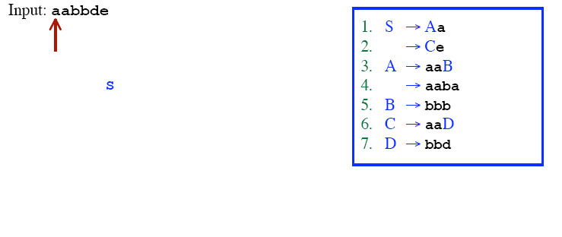
RECURSIVE DESCENT PARSING (BACKTRACKING)
‹#›

Slide 21
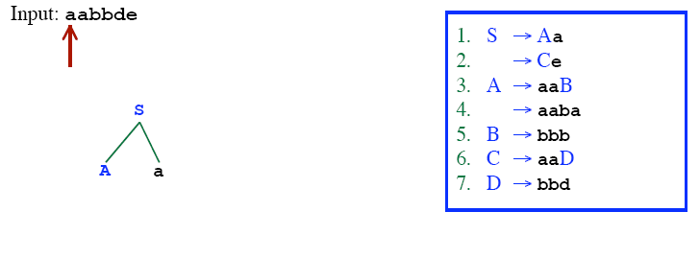
RECURSIVE DESCENT PARSING (BACKTRACKING)
‹#›

Slide 22
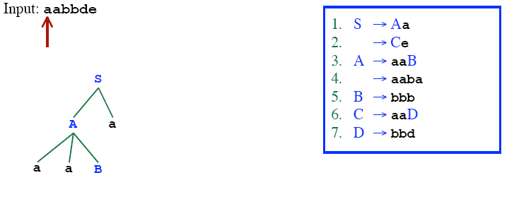
RECURSIVE DESCENT PARSING (BACKTRACKING)
‹#›

Slide 23
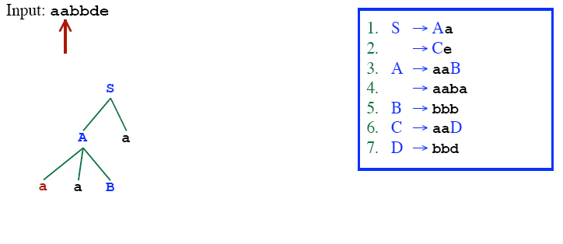
RECURSIVE DESCENT PARSING (BACKTRACKING)
‹#›

Slide 24
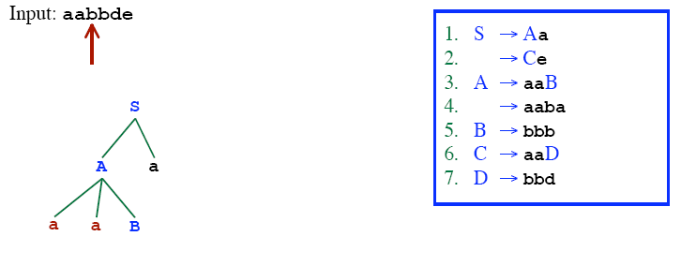
RECURSIVE DESCENT PARSING (BACKTRACKING)
‹#›

Slide 25
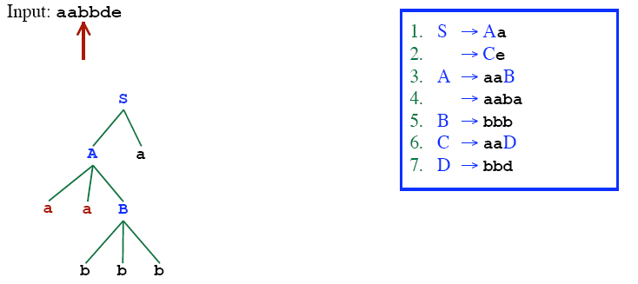
RECURSIVE DESCENT PARSING (BACKTRACKING)
‹#›

Slide 26
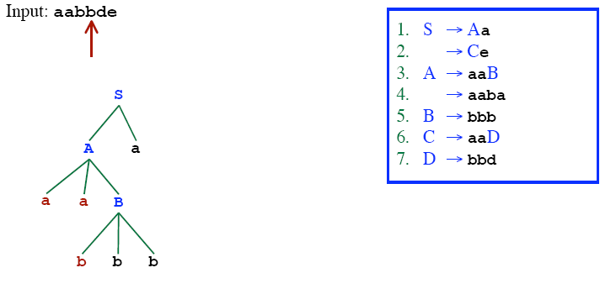
RECURSIVE DESCENT PARSING (BACKTRACKING)
‹#›

Slide 27
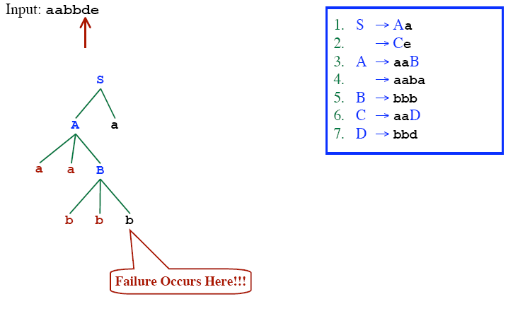
RECURSIVE DESCENT PARSING (BACKTRACKING)
‹#›

Slide 28
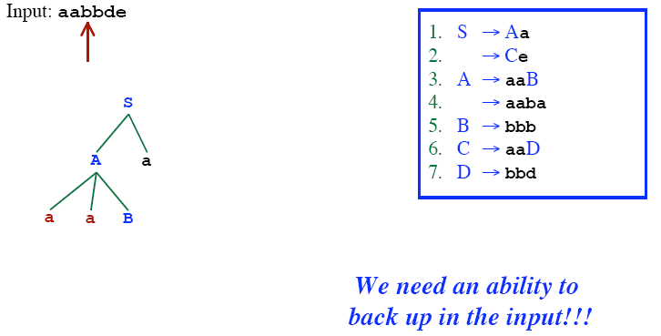
RECURSIVE DESCENT PARSING (BACKTRACKING)
‹#›

Slide 29
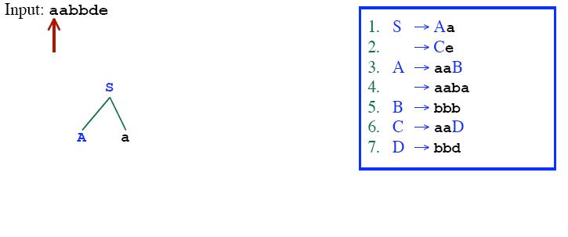
RECURSIVE DESCENT PARSING (BACKTRACKING)
‹#›

Slide 30
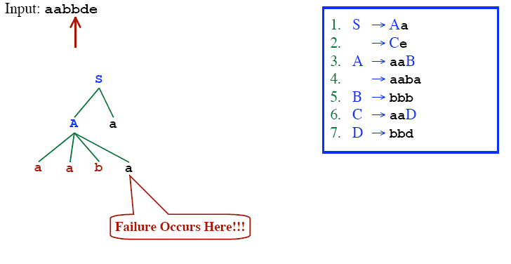
RECURSIVE DESCENT PARSING (BACKTRACKING)
‹#›

Slide 31
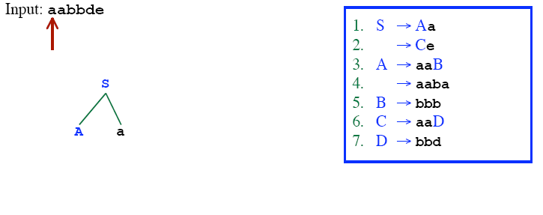
RECURSIVE DESCENT PARSING (BACKTRACKING)
‹#›

Slide 32
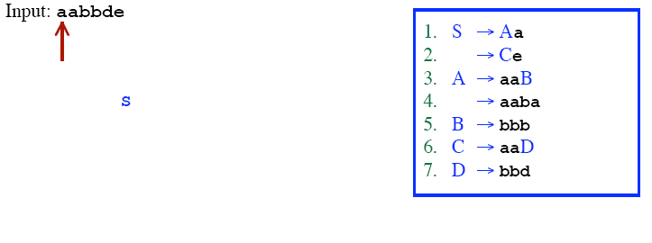
RECURSIVE DESCENT PARSING (BACKTRACKING)
‹#›

Slide 33
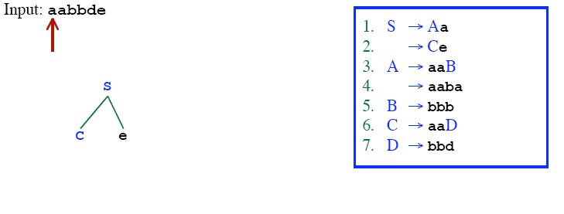
RECURSIVE DESCENT PARSING (BACKTRACKING)
‹#›

Slide 34
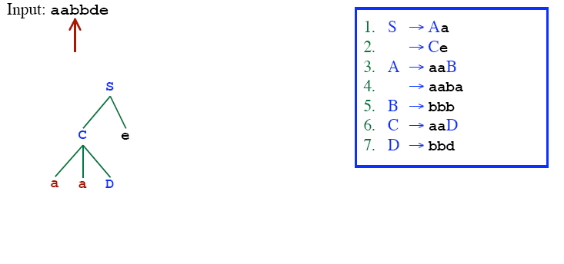
RECURSIVE DESCENT PARSING (BACKTRACKING)
‹#›

Slide 35
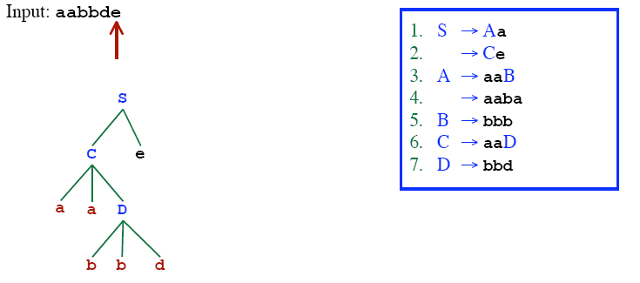
RECURSIVE DESCENT PARSING (BACKTRACKING)
‹#›

Slide 36
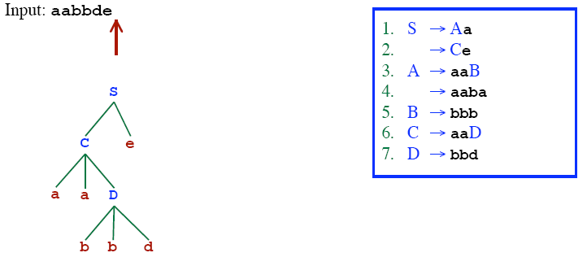
RECURSIVE DESCENT PARSING (BACKTRACKING)
‹#›
Successfully parsed!!

Slide 37
RECURSIVE-DESCENT PARSING ALGORITHM
A recursive-descent parsing program consists of a set of procedures – one for each non-terminal
Execution begins with the procedure for the start symbol
Announces success if the procedure body scans the entire input
void A(){
for (j=1 to t){ /* assume there is t number of A-productions */
Choose a A-production, A_{j}🡪X₁X₂…X_{k};
for (i=1 to k){
if (X_{i} is a non-terminal)
call procedure X_{i}();
else if (X_{i} equals the current input symbol a)
advance the input to the next symbol;
else backtrack in input and reset the pointer
}
}
}
‹#›

Slide 38
PREDICTIVE PARSER
When re-writing a non-terminal in a derivation step, a predictive parser can uniquely choose a production rule by just looking the current symbol in the input string.
A → α₁ | ... | α_{n} input: ... a .......
current token
‹#›

Slide 39
PREDICTIVE PARSER (EXAMPLE)
stmt → if ...... |
while ...... |
begin ...... |
for .....
When we are trying to write the non-terminal stmt, if the current token is if we have to choose first production rule.
When we are trying to write the non-terminal stmt, we can uniquely choose the production rule by just looking the current token.
We eliminate the left recursion in the grammar, and left factor it. But it may not be suitable for predictive parsing (not LL(1) grammar).
‹#›

Slide 40
RECURSIVE PREDICTIVE PARSING
Each non-terminal corresponds to a procedure.
Ex: A → aBb (This is only the production rule for A)
proc A {
- match the current token with a, and move to the next token;
- call ‘B’;
- match the current token with b, and move to the next token;
}
‹#›

Slide 41
RECURSIVE PREDICTIVE PARSING (CONT.)
A → aBb | bAB
proc A {
case of the current token {
‘a’: - match the current token with a, and move to the next token;
- call ‘B’;
- match the current token with b, and move to the next token;
‘b’: - match the current token with b, and move to the next token;
- call ‘A’;
- call ‘B’;
}
}
‹#›

Slide 42
RECURSIVE PREDICTIVE PARSING (CONT.)
When to apply ε-productions.
A → aA | bB | ε
If all other productions fail, we should apply an ε-production. For example, if the current token is not a or b, we may apply the ε-production.
Most correct choice: We should apply an ε-production for a non-terminal A when the current token is in the follow set of A (which terminals can follow A in the sentential forms).
‹#›

Slide 43
RECURSIVE PREDICTIVE PARSING (EXAMPLE)
A → aBe | cBd | C
B → bB | ε
C → f
proc C { match the current token with f,
proc A { and move to the next token; }
case of the current token {
a: - match the current token with a,
and move to the next token; proc B {
- call B; case of the current token {
- match the current token with e, b: - match the current token with b,
and move to the next token; and move to the next token;
c: - match the current token with c, - call B
and move to the next token; e,d: do nothing
- call B; }
- match the current token with d, }
and move to the next token;
f: - call C
}
}
follow set of B
‹#›
first set of C

Slide 44
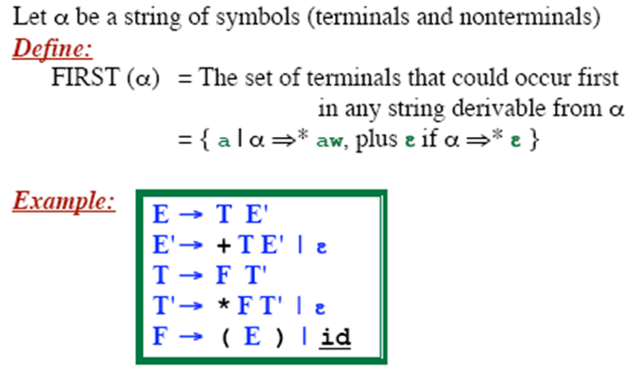
FIRST FUNCTION
FIRST (E) =
FIRST (E’) =
FIRST (T) =
FIRST (T’) =
FIRST (F) =
‹#›

Slide 45
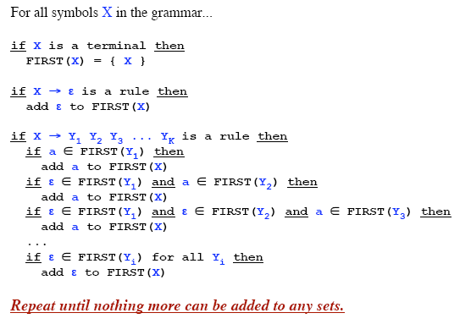
COMPUTING THE FIRST FUNCTION
‹#›

Slide 46
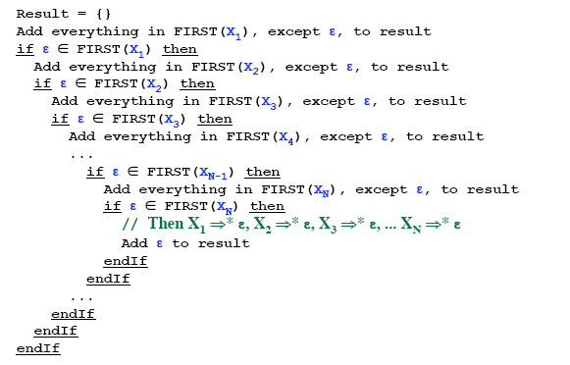
TO COMPUTE THE FIRST(X1X2X3...XN)
‹#›

Slide 47
FIRST - EXAMPLE
P 🡪 i | c | n T S
Q 🡪 P | a S | b S c S T
R 🡪 b | ε
S 🡪 c | R n | ε
T 🡪 R S q
FIRST(P) =
FIRST(Q) =
FIRST(R) =
FIRST(S) =
FIRST(T) =
‹#›
Notes:
‹#›

Slide 48
FIRST - EXAMPLE
P 🡪 i | c | n T S
Q 🡪 P | a S | b S c S T
R 🡪 b | ε
S 🡪 c | R n | ε
T 🡪 R S q
FIRST(P) = {i,c,n}
FIRST(Q) = {i,c,n,a,b}
FIRST(R) = {b,ε}
FIRST(S) = {c,b,n,ε}
FIRST(T) = {b,c,n,q}
‹#›
Notes:
‹#›

Slide 49
FIRST - EXAMPLE
S 🡪 a S e | S T S
T 🡪 R S e | Q
R 🡪 r S r | ε
Q 🡪 S T | ε
FIRST(S) =
FIRST(R) =
FIRST(T) =
FIRST(Q) =
‹#›
Notes:
‹#›

Slide 50
FIRST - EXAMPLE
S 🡪 a S e | S T S
T 🡪 R S e | Q
R 🡪 r S r | ε
Q 🡪 S T | ε
FIRST(S) = {a}
FIRST(R) = {r, ε}
FIRST(T) = {r, a, ε}
FIRST(Q) = {a, ε}
‹#›
Notes:
‹#›

Slide 51
FOLLOW SETS
FOLLOW(A) is the set of terminals (including end marker of input - $) that may follow non-terminal A in some sentential form.
FOLLOW(A) = {c | S ⇒⁺ …Ac…} ∪ {$} if S ⇒⁺ …A
For example, consider L ⇒⁺ (())(L)L
Both ‘)’ and end of file can follow L
NOTE: ε is never in FOLLOW sets
‹#›
Notes:
‹#›

Slide 52
COMPUTING FOLLOW(A)
If A is start symbol, put $ in FOLLOW(A)
Productions of the form B 🡪 α A β,
Add FIRST(β) – {ε} to FOLLOW(A)
Productions of the form B 🡪 α A or
B 🡪 α A β where β ⇒* ε
Add FOLLOW(B) to FOLLOW(A)
‹#›
Notes:
‹#›

Slide 53
EXAMPLE
FOLLOW(E) = {$}
FOLLOW(E′) =
FOLLOW(T) =
FOLLOW(T′) =
FOLLOW(F) =
E 🡪 T E′
E′ 🡪 + T E′ | ε
T 🡪 F T′
T′ 🡪 * F T′ | ε
F 🡪 ( E ) | id
FIRST(E) = {(, id}
FIRST(E′) = {+, ε}
FIRST(T) = {(, id}
FIRST(T′) = {*, ε}
FIRST(F) = {(, id}}
Using rule #1
If A is start symbol, put $ in FOLLOW(A)
‹#›
Assume the first non-terminal is the start symbol
Notes:
‹#›

Slide 54
EXAMPLE
E 🡪 T E′
E′ 🡪 + T E′ | ε
T 🡪 F T′
T′ 🡪 * F T′ | ε
F 🡪 ( E ) | id
FIRST(E) = {(, id}
FIRST(E′) = {+, ε}
FIRST(T) = {(, id}
FIRST(T′) = {*, ε}
FIRST(F) = {(, id}}
FOLLOW(E) = {$, )}
FOLLOW(E′) =
FOLLOW(T) = {+}
FOLLOW(T′) =
FOLLOW(F) = {*}
Using rule #2
Productions of the form B 🡪 α A β,
Add FIRST(β) – {ε} to FOLLOW(A)
‹#›
Notes:
‹#›

Slide 55
EXAMPLE
E 🡪 T E′
E′ 🡪 + T E′ | ε
T 🡪 F T′
T′ 🡪 * F T′ | ε
F 🡪 ( E ) | id
FIRST(E) = {(, id}
FIRST(E′) = {+, ε}
FIRST(T) = {(, id}
FIRST(T′) = {*, ε}
FIRST(F) = {(, id}}
FOLLOW(E) = {$, )}
FOLLOW(E′) = FOLLOW(E)
= {$, )}
FOLLOW(T) = {+} ∪ FOLLOW(E′)
= {+, $, )}
FOLLOW(T′) = FOLLOW(T)
= {+, $, )}
FOLLOW(F) = {*} ∪ FOLLOW(T′)
= {*, +, $, )}
Using rule #3
Productions of the form B 🡪 α A or
B 🡪 α A β where β ⇒* ε
Add FOLLOW(B) to FOLLOW(A)
‹#›
Notes:
‹#›

Slide 56
EXAMPLE
S 🡪 ( A) | ε
A 🡪 T E
E 🡪 & T E | ε
T 🡪 ( A ) | a | b | c
FIRST(T) =
FIRST(E) =
FIRST(A) =
FIRST(S) =
FOLLOW(S) =
FOLLOW(A) =
FOLLOW(E) =
FOLLOW(T) =
‹#›
Notes:
‹#›

Slide 57
EXAMPLE
S 🡪 ( A) | ε
A 🡪 T E
E 🡪 & T E | ε
T 🡪 ( A ) | a | b | c
FIRST(T) = {(,a,b,c}
FIRST(E) = {&, ε }
FIRST(A) = {(,a,b,c}
FIRST(S) = {(, ε}
FOLLOW(S) = {$}
FOLLOW(A) = { ) }
FOLLOW(E) = FOLLOW(A) = { ) }
FOLLOW(T) = FIRST(E) ∪ FOLLOW(E) = {&, )}
‹#›
Notes:
‹#›

Slide 58
EXAMPLE
S 🡪 a S e | B
B 🡪 b B C f | C
C 🡪 c C g | d | ε
FIRST(C) =
FIRST(B) =
FIRST(S) =
FOLLOW(C) =
FOLLOW(B) =
FOLLOW(S) = {$}
Assume the first non-terminal is the start symbol
If A is start symbol, put $ in FOLLOW(A)
2. Productions of the form B 🡪 α A β,
Add FIRST(β) – {ε} to FOLLOW(A)
Productions of the form B 🡪 α A or
B 🡪 α A β where β ⇒* ε
Add FOLLOW(B) to FOLLOW(A)
‹#›
Notes:
‹#›

Slide 59
EXAMPLE
S 🡪 a S e | B
B 🡪 b B C f | C
C 🡪 c C g | d | ε
FIRST(C) = {c,d,ε}
FIRST(B) = {b,c,d,ε}
FIRST(S) = {a,b,c,d,ε}
FOLLOW(C) =
FOLLOW(B) =
FOLLOW(S) = { }
_{{f,g} ∪ FOLLOW(B)}
_{= {c,d,e,f,g,$}}
_{{c,d} ∪ FOLLOW(S)}
_{= {c,d,e,$}}
_{$, e}
‹#›
Notes:
‹#›

Slide 60
QUESTIONS ?
‹#›

